Slide 1
Big Mountain resort
Findings, solutions & recommendations
HAUWANAT A. BALOGUN

Slide 2
Problem identification
How can Big Mountain Resort select better values for ticket prices that are above average ticket price?

Slide 3
Project background
Big Mountain Resort, a ski resort located in Montana, with access to 105 trails, Glacier national Park, and Flathead National Forest views, accommodates approximately 350,000 people yearly. They are currently serviced by 11 lifts, 2 T-bars, and 1 magic carpet (for novice skiers). An additional chair lift has been added in order to help increase distribution of visitors across the mountain. Big Mountain will need to capitalize on increasing ticket prices far above average prices, and cut costs without undermining ticket prices.

Slide 4
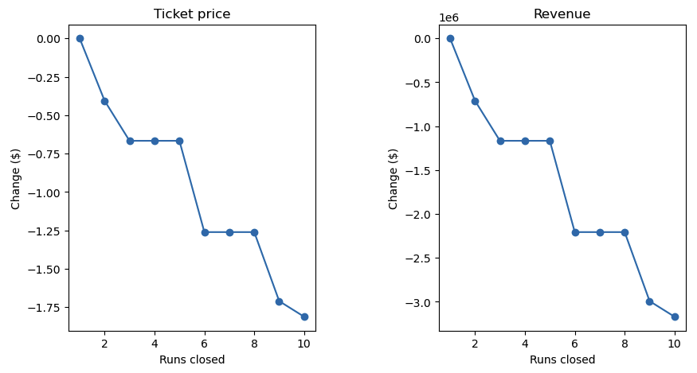
Modeling results & analysis
SCENARIO 1
Closing 1 run did not affect the revenue at all. ($0)
Closing 2 runs affects revenue by decrease of approximately $500,000
Closing 3 to 5 runs affects revenue by decrease of approximately $1M
Closing 6 to 8 runs also decreased the revenue by approximately $2.3M.
Closing 9 runs decreased revenue by approximately $3M
Closing 10 runs decreased revenue significantly by well over $3M
Fig. 1. Big Mountain's Total Price and Revenue per Runs closed
Operating cost per run is unknown, and therefore how much cost saving will offset loss in revenue with closing multiple runs, cannot be determined.

Slide 5
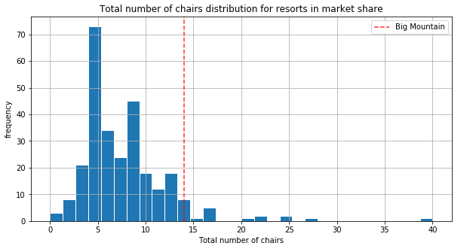
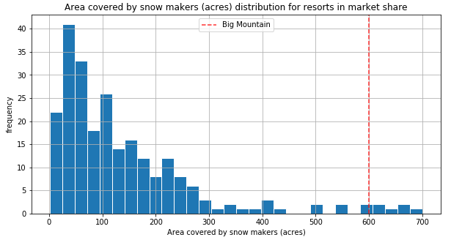
SCENARIOS 2 & 3
Scenarios 2
Increasing vertical drop by 150ft
Installation of additional chairs
Scenario 3
Increasing vertical drop by 150ft
Addition of 2 acres of snow making cover
Fig. 2. Big Mountain among resorts with highest number of chairs
Fig. 3. Big Mountain with one of the highest snow making area

Slide 6
Scenario 4
Increase run by ¼ mile & adding 4 acres of snow making cover generates no revenue at all.
Longest run feature was used in a linear model. The random forest model was chosen due to it having the best performance, and acted as a control for determining this scenario.

Slide 7
Recommendations and key findings
KEY FINDINGS
RECOMMENDATIONs
Big Mountain Resort is undercharging for ticket prices at $81.00, versus other resorts with average price of $95.87
Increase vertical drop (by 150ft.) and install additional chair lifts without additional snow making coverage, which will:
Increase ticket price to $8.61
Generate revenue of $15,065,471 (over the course of when the resort is open)
Increase vertical drop (by 150ft) and adding 2 acres of snow making cover, which results in:
Increase ticket price to $9.90
Generate revenue of $17,322,717 (over course of when resort is open)

Slide 8
Summary & conclusion
Following the application for ski resort ticket price in order for Big Mountain to leverage and explore potential scenarios for increasing revenue, it is concluded that the scenario with the best outcome would be scenario 2, in which:
Vertical drop is increased by 150ft
Adding additional chair lift without the addition of snow making.
This scenario increases ticket price by $1.99, and increases revenue by approximately $3.5 million (not including deduction of operating costs).
The data given was on a small-scale. As a result, closing down used run was not on the list of recommendations

